Slide 1

Bank Loan Analysis
Group 02 Members
Janhavi Sawant
Sheetal Daph
Manisha Choudhary
Nilesh Gupta
Bhagaban Desudu
Rushikesh Patil
Swati Guntamukkal

Slide 2
Introduction
The Bank Loan Dashboard project has been designed to monitor, assess, and provide insights into the bank's lending activities and performance.
Loans dashboard displays summary of total borrowings done by the customer in all accounts along with the current outstanding amount.
It allows customers to understand their current position with respect to loan accounts
The Summary Dashboard captures key loan-related metrics and their changes over time, providing a snapshot of the loan portfolio's health and lending strategy impact. It includes the following KPIs:
Total Loan Applications (MTD and MoM)
Total Funded Amount (MTD and MoM)
Total Amount Received (MTD and MoM)
Average Interest Rate (MTD and MoM)

Slide 3
Objectives
The main goal was to take a handful of important performance metrics (KPIs) and turn them into easy-to-understand visualizations.
The aim was to create clear charts and graphs that not only tackled the specific KPIs given but also made it simple for everyone to grasp how the company was doing.

Slide 4
Columns
loan_amnt
funded_amnt
grade
sub_grade
home_ownership
annual_inc
verification_status
loan_status
addr_state
total_pymnt
last_pymnt_d
last_pymnt_amnt
last_credit_pull_d

Slide 5
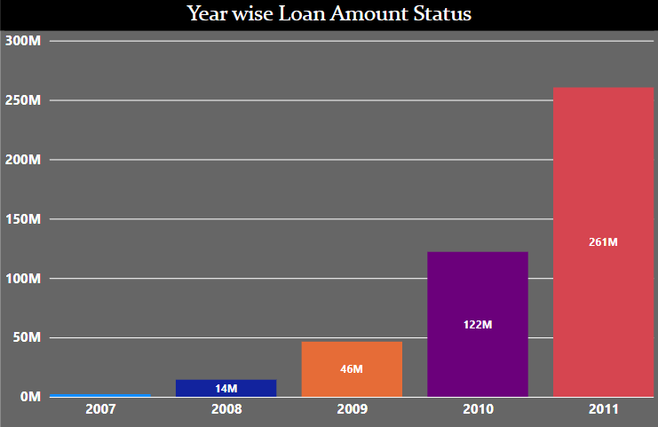
Year wise loan amount status
The KPI 1 is to find out the relation between loan amount taken by customers and issue_d.
It compares the loan amount taken by customers from year to year.To show the raise or drop in loan amount taken line chart is used.
There is a significant increase in loan amounts over the years, particularly in 2011, where the loan amount skyrockets to 261 million.
The loan amounts appear to have grown rapidly from 2007 to 2011, indicating a possible expansion in lending activities.

Slide 6
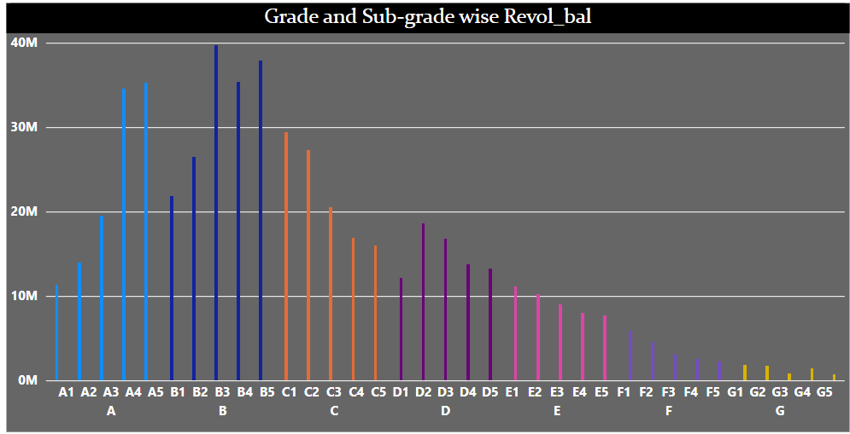
Grade and sub-grade wise Revol_Bal:-
The KPI 2 is to find out the relation between Grade , sub-grade and revol_bal.It shows the total revol_bal contributed from each sub-grade and grade.
Loans are categorized by grades (A to E), with sub-grades within each grade.
Higher revolving balances are observed in higher grades (A and B), with a significant drop as the grades decrease. This suggests that higher-grade loans tend to have higher credit lines or balances.

Slide 7
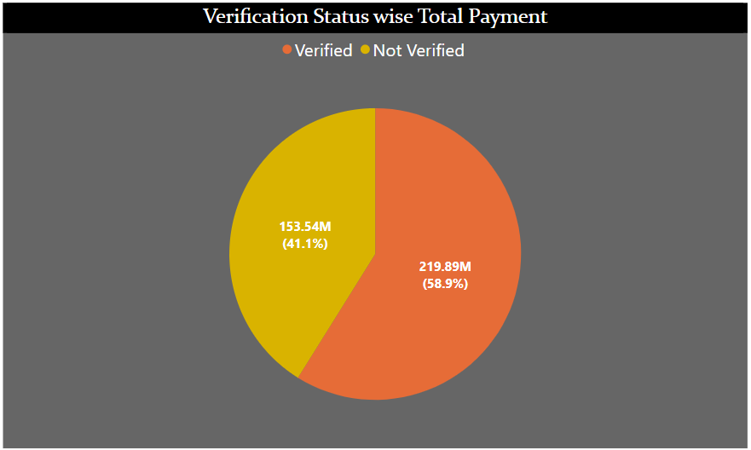
Verification status wise total payment
The KPI 3 is to find out the relation between loan amount taken by customers and issue_d.To show verified vs non-verified customers contribution for total payments. We used donut chart.
Loans that are non-verified have a total payment of 153.5 million (41.1%), while verified loans have a total payment of 219.9 million (58.9%).
Non-verified loans contribute more to total payments, which could indicate either a higher number of such loans or larger loan amounts.

Slide 8
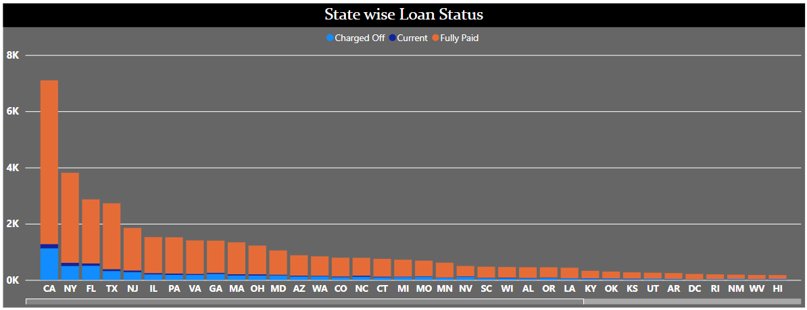
State wise loan status
The stacked column chart is used to represent the state wise loan status.
California (CA) leads in the number of loans across all statuses (Charged Off, Current, Fully Paid). New York (NY) and Florida (FL) follow but with much lower figures.
Higher lending activity in California state.

Slide 9
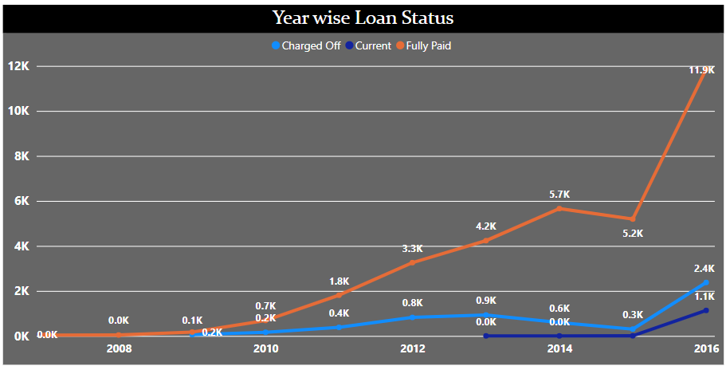
Year wise loan status
To represent the last_credit_pull_d wise loan status, the line chart has been used.
The number of loans that are fully paid has been increasing sharply, particularly from 2013 onwards, indicating a growing repayment trend.
The charged-off loans remain relatively low, showing better performance in recent years.

Slide 10
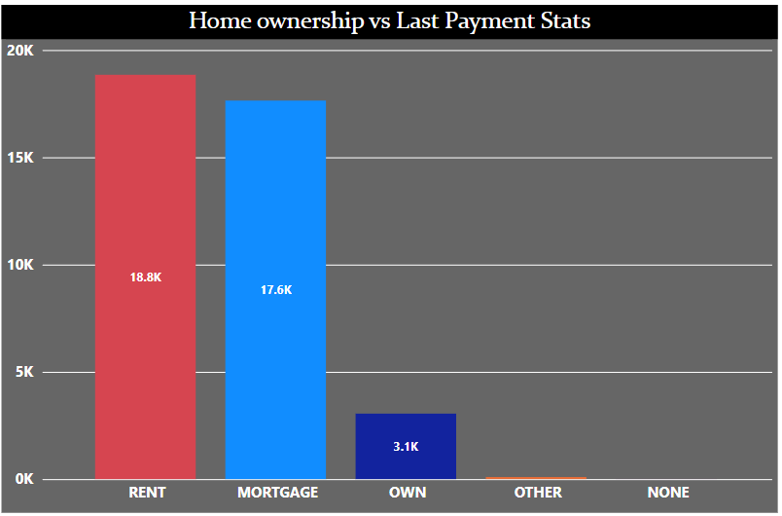
Home ownership vs last payment status:-
The KPI5 is to find out the relation between home ownership of customers and last payment date. To compare the last payment of customers with their home ownership status.
Here is total 5 categories that is Rent, Mortgage, Own, Other, None.
Renters (18.8k) and those with mortgages (17.6k) dominate the loan repayments, with a significantly lower number of loans from those who own their homes outright (3.1k). This could reflect a higher demand for loans among renters and mortgage holders.

Slide 11
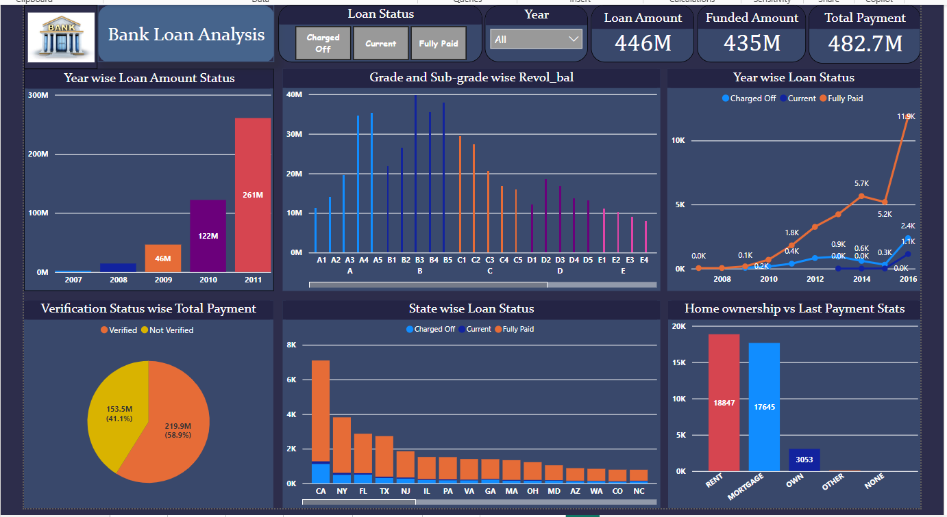

Slide 12
Conclusion
The bank loan analysis dashboard reveals significant growth in the bank's lending activities, especially from 2007 to 2011.
Loan repayments have shown a strong upward trend, particularly in recent years, with a significant portion of the portfolio being fully paid off.
Higher-grade loans tend to have higher balances, and the majority of payments come from verified loans.
Geographically, California is the most significant market for loans.
The loan portfolio is more prominent among renters and those with mortgages, indicating a strong link between housing status and loan demand.

Slide 13
Thank You

